Slide 1



SMART INDIA HACKATHON 2026
Problem Statement ID - 26034
Problem Statement Title - Software System to check compliance of Packaged Commodities under Legal Metrology (Packaged Commodities) Rules, 2011 by scanning products, images and labels.
Theme - Miscellaneous
PS Category - Software
Team ID - K26234
Team Name - HexTech

Slide 2


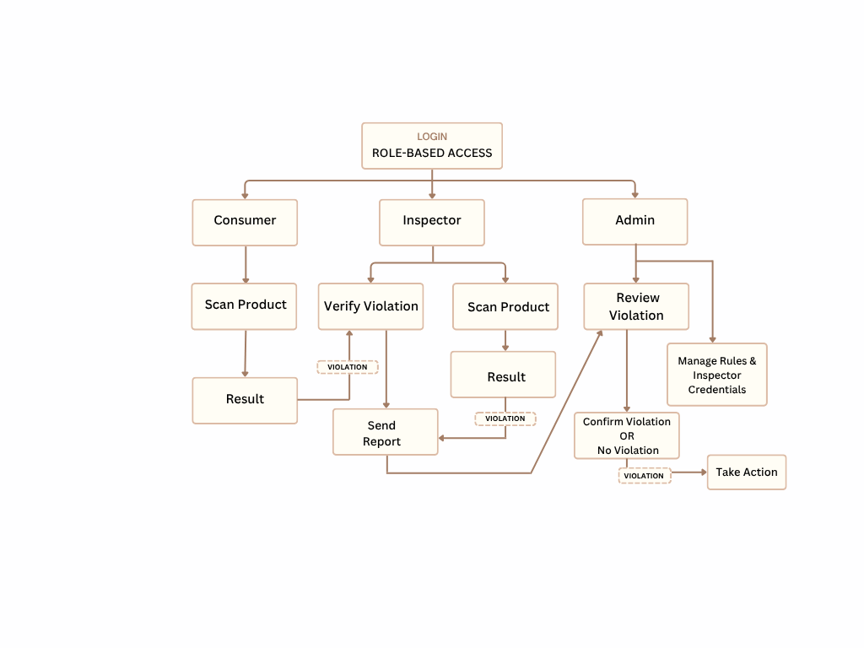
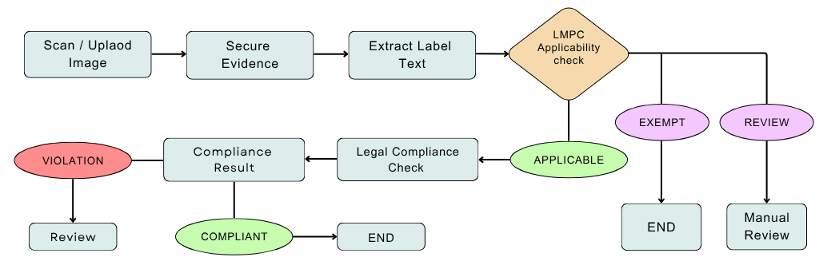
Proposed Solution
HexTech
Problem:
  Checking each label manually takes a lot of time, and mistakes are easy to make.
  Most people don't know what a label must contain, so missing or misleading details go unnoticed.
Innovation & Uniqueness:
  Secure Evidence - Image + GPS + timestamp + Evidence ID + SHA-256
  Compliance Management - Admin can update or modify the rules when they are revised.
  Human Verification - Unclear results - REVIEW with Inspector and Controller approval
ROLE-BASED SYSTEM WORKFLOW
COMPLIANCE VERIFICATION WORKFLOW
@SIH Idea submission- Template
2

Slide 3

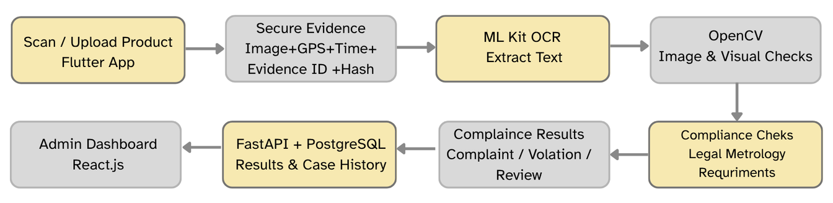
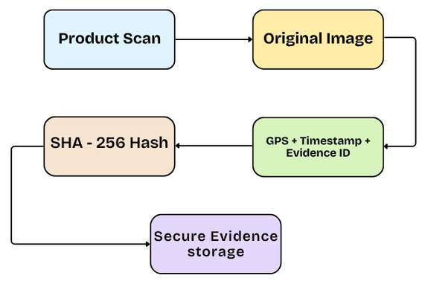

TECHNICAL APPROACH
HexTech
Technology Workflow
Compliance Check
  Rule 6 : Mandatory declarations, MRP, quantity & manufacturer details
  Rule 7 : Font size & declaration visibility
  Rule 8 : Declaration placement / display panel
  Rule 13 : Net quantity declaration
  Rule 17 : Declaration format & visibility
  Rule 27 : LMPC registration verification
Barcode-Based Compliance Verification
Secure Evidence
Barcode-Based Font Size Estimation
Barcode-Based Product Verification
  Barcode as Scale - Known barcode width converts pixels into millimetres.
  Text Measurement - ML Kit measures letter height in pixels.
  Rule 7(2) Check - Converted text height is compared with the legal minimum.
GTIN is used to identify the product and retrieve available reference information.
Scan Barcode
Identify Product (GTIN)
Check Product
Compare
ML Kit fails to detect the barcode → Server-side Pyzbar extracts the barcode
@SIH Idea submission- Template
3

Slide 4
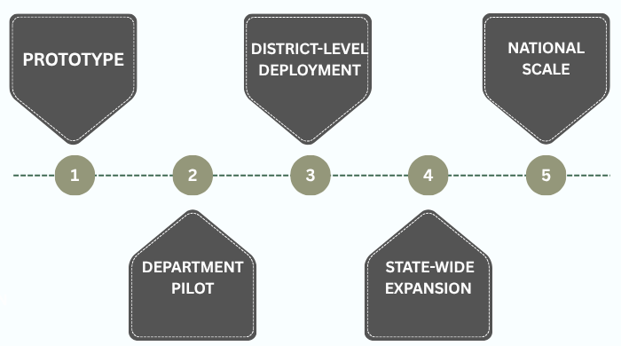
FEASIBILITY AND VIABILITY
HexTech
Feasibility
  Technical - OCR, barcode, and rule checks work automatically.
  Operational - Inspector takes one photo and gets the details.
  Cost - Uses phones and free tools.
  Scalable - Start with one district and expand.
Phased Implementation & Scalability
Potential Challenges & Strategies
Real-world problem | System response
Blurry or shiny photo | Marked REVIEW, a person checks it
OCR reads something wrong | User can correct it, and the change is saved
Product not in our registry | Shown as not verified, no complaint raised
Evidence tampering | Fingerprint, place and time expose it
Google ML Kit cannot recognize the barcode | Use server-side Pyzbar to extract the barcode
Prototype Success Targets
  OCR Accuracy: ≥92% on clear labels
  Inspection Time: ≤45 sec per item
  False-Positive Rate: <5% after human verification
@SIH Idea submission- Template
4

Slide 5
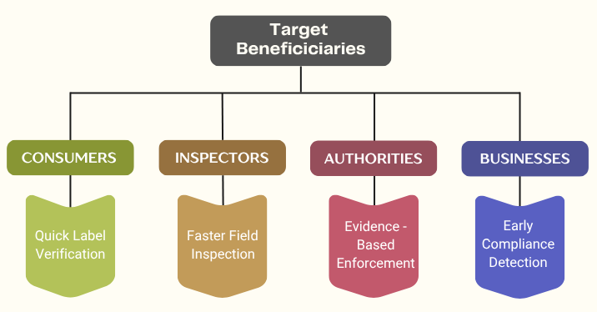
IMPACT AND BENEFITS
HexTech
Benefits
  Faster identification of label compliance issues
  Less manual checking and inspection effort
  Structured and secure digital evidence
  Standardized and consistent rule-based checks
  Easy digital reporting and case management
Future Scope
  E-Commerce Compliance - Online product listing checks
  Multilingual Support - Regional-language labels
  Advanced Visual Checks - Better label analysis
  National-Scale Deployment - Expand across inspection teams
  AI Model Enhancement - Improve product and label recognition with advanced models
Expected Impact
  Inspector - Less repetitive manual checking
  Department - Structured inspection records
  Consumer - Better visibility of required declarations
  Enforcement - Traceable digital evidence
@SIH Idea submission- Template
5

Slide 6
HexTech
RESEARCH AND REFERENCES
Research Insights and Our Proposed Approach
Official Sources
Legal Metrology Act & Rules https://consumeraffairs.gov.in/pages/legal-metrology-act
Packaged Commodities Registration Portal https://lm.doca.gov.in/pcr/certificates
National Consumer Helpline https://consumerhelpline.gov.in/public/
  Automated Product Recognition
Research: Computer vision identifies products from real-world images.
Gap: Product recognition does not verify legal declarations.
Our Approach: Barcode/GTIN identifies the product; OCR checks label details.
https://www.nature.com/articles/s41598-026-42266-9
  Secure Evidence & Legal Metrology Enforcement
Change: 2026 reforms introduced Improvement Notices for specified first-time non-compliances.
Gap: Inspection evidence needs traceability and integrity.
Our Approach: Image + GPS + time + Evidence ID + SHA-256 secure the evidence record.
https://www.pib.gov.in/PressReleasePage.aspx?PRID=2278745&lang=1&reg=3
Prototype Demo Video:
Prototype Video Link
Scan Smart. Verify Right. Protect All
@SIH Idea submission- Template
6

